Slide 1




Slide 2





●
●
●
●
●

Slide 3


Slide 4






●
●
●
●
●
●

Slide 5


Slide 6





●
○
■
■
■
○
■
■
■

Slide 7










●
○
●
○
○
○
○
○
○
h1 {
font-family: Helvetica, Arial, sans-serif;
}
●

Slide 8

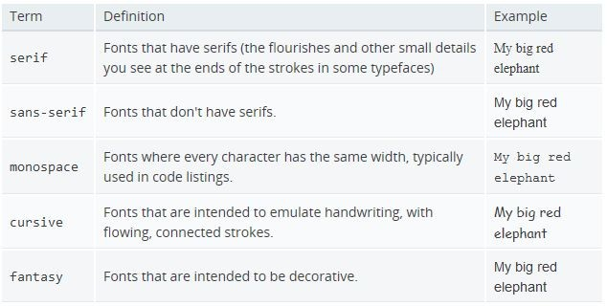
●

Slide 9

●
●
You can use @font-face to load fonts from a local folder or from the Internet
The loaded fonts are then available to be used anywhere on the page
@font-face {
font-family: Fancy;
src: url('Fancy-Bold.ttf');
}
.my_class {
font-family: Fancy; font-size: 3.2em;
}

Slide 10






●
●
h1 { font-size: 16px; } p { font-size: 1.33em; }
○
○
span { font-size: 0.83rem; }
■
○
■
- recommended

Slide 11























p {
font-style: italic; font-weight: bold;
text-transform: capitalize;
text-decoration: underline;
}
●
○
○
●
○
○
●
○
○
●
○
○

Slide 12












●
●
p { text-shadow: 2px 2px 7px #000000; }
Chapter two
12

Slide 13





















●
○
○
●
○
○
●
○
○
●
○
○

Slide 14







●
●
●
●
p { text-overflow: clip ellipsis; }

Slide 15










●
●
p { font:
italic normal bold normal 3em/1.5
Arial, sans-serif;
}
/

Slide 17
















●
●
●
■
■
■
■

Slide 18


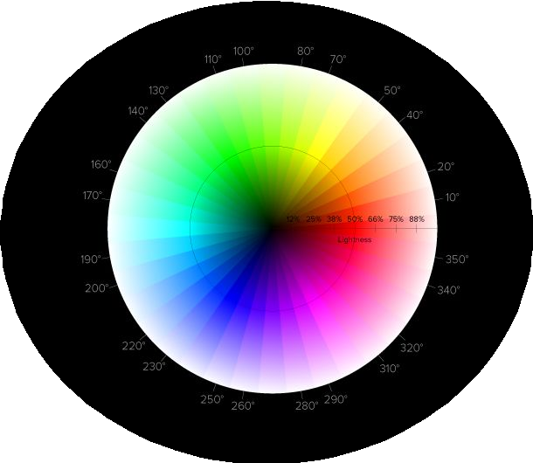









●
○
●
○
.p1 { color: rgba(255, 255, 0, 0.5); }
.p2 { background-color: hsla(240, 100%, 50%, 0.5); }
.p3 { opacity: 0.5; }

Slide 19








●
○
●
○
●
○
○
●
○
○
●
○
○

Slide 20







●
●
div { background: #FFF0C0
url("bg.gif")
no-repeat fixed top;
}

Slide 21





●
●
●
div { background-image: url(“sheep.png”), url(“grass.png”); }

Slide 22








●
●
●
div { background-image: linear-gradient( to bottom,
yellow,
orange);
}

Slide 23

●
a.
b.
●

Slide 24


Slide 25














●
●
●

Slide 26
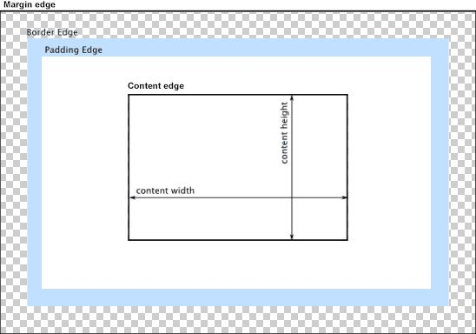

Slide 27











●
●
●
■
■
■
■

Slide 28





●
○
○
●
○
●
○
○

Slide 29









●
●
<p>The bottom margin of this p is collapsed</p>
<p>with the top margin of this paragraph.</p>
○
○
■
○
■

Slide 30


Slide 31






●
○
●
○
○
○

Slide 32







●
○
●
○
○
○
○
●
○

Slide 33







●
●
○
○
○
■
○

Slide 34



●
○
○
○
○

Slide 35







●
○
○
○
○
●
○
○

Slide 36









●
●
○
○
○
●
○
○
○
○

Slide 37






●
○
○
○
●
●

Slide 38








●
○
○
○
●
○
●

Slide 39

Text Styling (MDN)
CSS Values and Units (MDN)
Box Model (MDN)
Old but very good positioning tutorial: http://www.barelyfitz.com/screencast/html-training/css/positioning/
CSS positioning interactive:
https://medium.freecodecamp.com/css-positioning-explained-by-building-an-ice-cream-sundae-831cb88 4bfa9 & https://www.rtfmanual.io/csssundae/
Learn layout: http://learnlayout.com/
Position (MDN) & Positioning example (MDN)
A Guide To Flexbox (CSS Tricks)

